Slide 1
Lecture 5 Uncertainty and Probabilistic Reasoning
AY 2024-25

Slide 2

L5 – Uncertainty & Probabilistic Reasoning
Uncertainty and Probabilistic Reasoning
Bayes’ Rule
Probabilistic Programming in Pyro

Slide 3
1. Uncertainty
Uncertainty
Examples
Causes
Methodology

Slide 4
Uncertainty
In AI, when an agent knows enough facts about its environment, the logical plans and cations produces a guaranteed work.
Unfortunately, agents never have access to the whole truth about their environment. Agents act under uncertainty.

Slide 5
Examples of Uncertainty
Some common examples of uncertainty:
Weather Forecast
Financial Market
Health Diagnosis
Sports Outcome

Slide 6
Causes of Uncertainty
Here are some major causes of uncertainty to occur in the real world:
Information occurred from unreliable sources;
Experimental errors;
Equipment fault;
Temperature variation; and
Climate change.

Slide 7
Dealing with Uncertainties
In AI, agents deal with uncertainty by the following methods:
Probabilistic Reasoning: Agents can use probabilistic models, such as Bayesian networks or Markov decision processes, to reason under uncertainty.
Monte Carlo Methods: such as Monte Carlo simulation or Monte Carlo tree search
Ensemble Learning: combine multiple models or predictions such as bagging or boosting

Slide 8
2. Probability
Probability Basics
Bayes’ rules

Slide 9
Probability VS. Artificial Intelligence
Data is important to gather AI ability
In analytics process, we usually use random variables to describe the data. Why?
Mathematical process to solve AI problems
To make the data (input) computable
To find the patterns behind data (for decision making)
Allows the analysis of statistics (practical)
Probability helps predict likely that an event will happen
E.g., weather prediction, product recommendation.

Slide 10
Probabilistic Reasoning
Probabilistic reasoning is a way of knowledge representation where we apply the concept of probability to indicate the uncertainty in knowledge.
In probabilistic reasoning, we combine probability theory with logic to handle the uncertainty.
Probability provides a way to handle the uncertainty that is the result of someone's laziness and ignorance.

Slide 11

Probabilistic Reasoning (2)
In the real world, there are lots of scenarios, where the certainty of something is not confirmed, such as
"It will rain today,"
"Behavior of someone for some situations,"
"A match between two teams or two players."
These are probable sentences for which we can assume that it will happen but not sure about it, so here we use probabilistic reasoning.

Slide 12
Solving Problem with Uncertainty
In probabilistic reasoning, there are two ways to solve problems with uncertain knowledge:
Bayes' rule
Bayesian Statistics

Slide 13
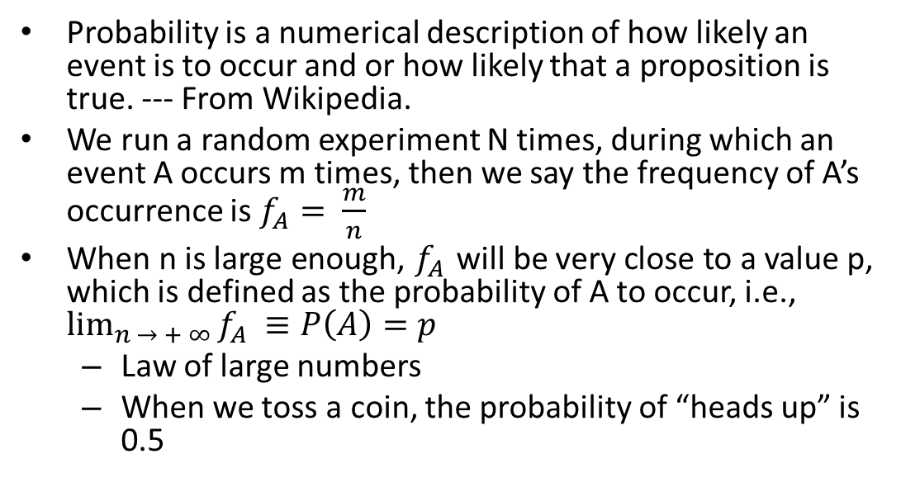
What is Probability?
Probability is a numerical description of how likely an event is to occur and or how likely that a proposition is true. --- From Wikipedia.
We run a random experiment N times, during which an event A occurs m times, then we say the frequency of A’s occurrence is $f_{A}= \frac{m}{n}$
When n is large enough, $f_{A}$will be very close to a value p, which is defined as the probability of A to occur, i.e., $\lim_{n → + ∞}{f_{A} ≡P\left(A\right)=p}$
Law of large numbers
When we toss a coin, the probability of “heads up” is 0.5

Slide 14
Sample Space
The set of all possible outcomes of an experiment
Example: coin flipping
What are the possible outcomes?
The coin lands Heads up – H
The coin lands Tails up – T
The sample space: S = {H, T}
For fair coins
What are the chances of G and H happening?
Empirically, H and T have 50-50 chance to happen.
The probability for H to happen is 50% (0.5), so does T

Slide 15
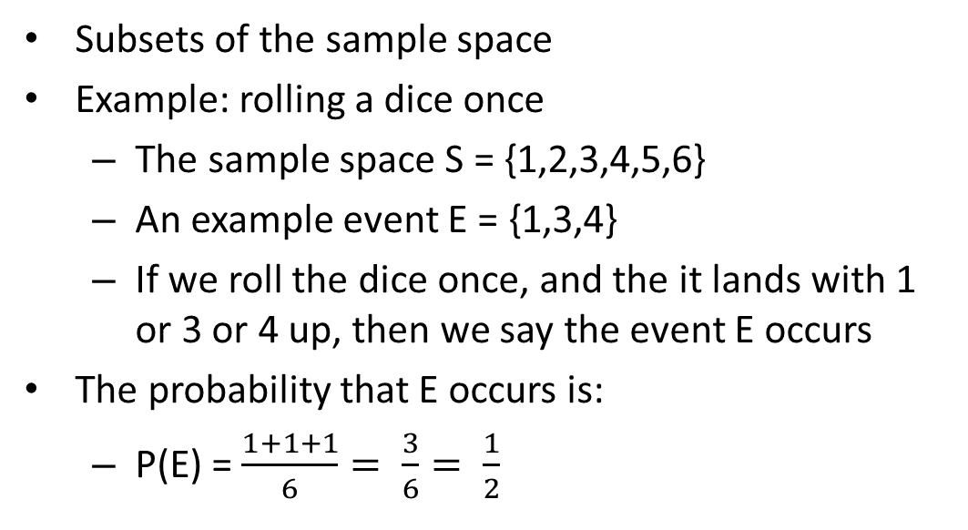
Event
Subsets of the sample space
Example: rolling a dice once
The sample space S = {1,2,3,4,5,6}
An example event E = {1,3,4}
If we roll the dice once, and the it lands with 1 or 3 or 4 up, then we say the event E occurs
The probability that E occurs is:
P(E) = $\frac{1+1+1}{6}= \frac{3}{6}= \frac{1}{2}$

Slide 16
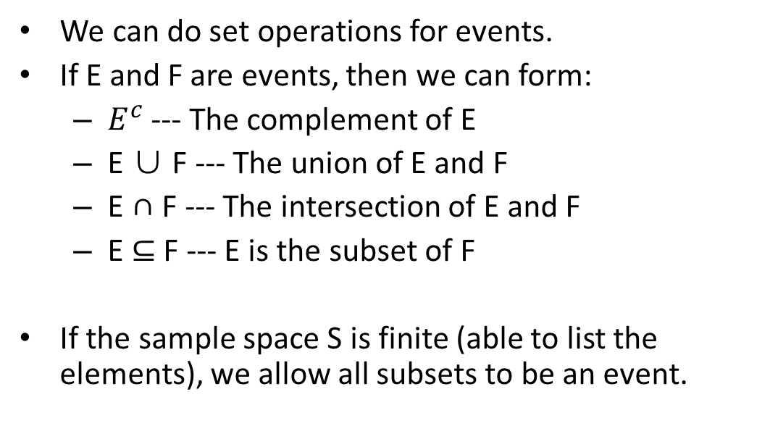
The Algebra of Events
We can do set operations for events.
If E and F are events, then we can form:
$E^{c}$--- The complement of E
E ∪ F --- The union of E and F
E ∩ F --- The intersection of E and F
E ⊆ F --- E is the subset of F
If the sample space S is finite (able to list the elements), we allow all subsets to be an event.

Slide 17

Basic Probability
Probability can be defined as a chance that an uncertain event will occur.
It is the numerical measure of the likelihood that an event will occur.
The value of probability always remains between 0 and 1 that represent ideal uncertainties.
The probability of an uncertain event:

Slide 18
Basic Probability (2)
Some basic properties of probability:
0 ≤ P(A) ≤ 1, where P(A) is the probability of an event A.
P(A) = 0, indicates total uncertainty in an event A.
P(A) = 1, indicates total certainty in an event A.
P(¬A) = probability of a not happening event.
P(¬A) + P(A) = 1.

Slide 19
Basic Probability (3)
Basic terms in probability:
Event: Each possible outcome of a variable is called an event.
Sample space: The collection of all possible events is called sample space.
Random variables: Random variables are used to represent the events and objects in the real world.
Prior probability: The prior probability of an event is probability computed before observing new information.

Slide 20
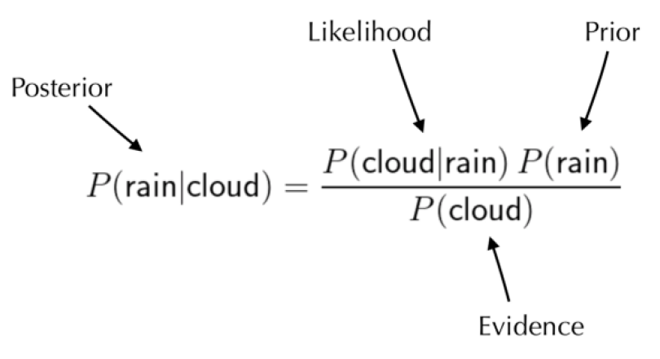
Basic Probability (4)
Basic terms in probability (cont.):
Posterior Probability: The probability that is calculated after all evidence or information has taken into account. It is a combination of prior probability and new information.

Slide 21

Conditional Probability
Conditional probability is a probability of occurring an event when another event has already happened.
Suppose we want to calculate the event A when event B has already occurred, "the probability of A under the conditions of B", it can be written as:
where P(A⋀B) = Joint probability of A and B;
P(B) = Marginal probability of B.

Slide 22

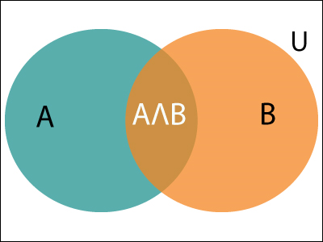
Conditional Probability (2)
If the probability of A is given and we need to find the probability of B, then it will be given as:
It can be explained by using the left Venn diagram, where B is occurred event, so sample space will be reduced to set B.
And now we can only calculate event A when event B is already occurred by dividing the probability of P(A⋀B) by P( B ).

Slide 23
Conditional Probability (3)
Let’s look an example:
In a class, there are 70% of the students who like Java and 40% of the students who likes Java and Python, and then what is the percent of students those who like Java also like Python?

Slide 24

Conditional Probability (4)
Solution:
Let A be an event that a student likes Python; and B be an event that a student likes Java.
So, 57% are the students who like Java also like Python.

Slide 25
Bayes’ Theorem
Bayes' theorem is also known as Bayes' rule, Bayes' law, or Bayesian reasoning, which determines the probability of an event with uncertain knowledge.
In probability theory, it relates the conditional probability and marginal probabilities of two random events.
Bayes' theorem was named after the British mathematician Thomas Bayes.
The Bayesian inference is an application of Bayes' theorem, which is fundamental to Bayesian statistics.

Slide 26
Bayes’ Theorem (2)
Bayes’ Theorem gives us a way to calculate the value of P(A|B) with the knowledge of P(B|A).
It allows updating the probability prediction of an event by observing new information of the real world.
Example: If cancer corresponds to one's age then by using Bayes' theorem, we can determine the probability of cancer more accurately with the help of age.

Slide 27
Bayes’ Theorem (3)
Bayes’ Theorem can be derived using product rule and conditional probability of event A with known event B:
As from product rule we can write:
P(A ⋀ B) = P(A|B) P(B) or
Similarly, the probability of event B with known event A:
P(A ⋀ B) = P(B|A) P(A)

Slide 28
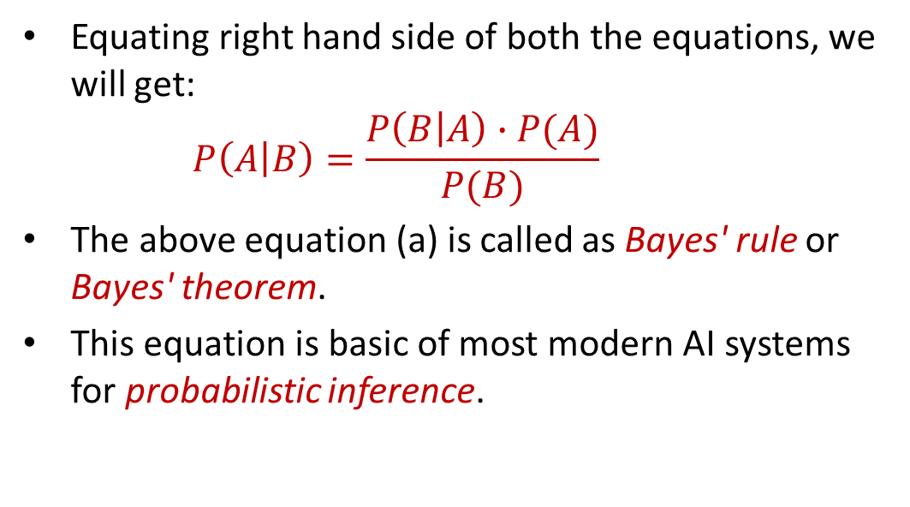
Bayes’ Theorem (4)
Equating right hand side of both the equations, we will get:
$$P\left(A | B\right)=\frac{P\left(B | A\right)∙P(A)}{P(B)}$$
The above equation (a) is called as Bayes' rule or Bayes' theorem.
This equation is basic of most modern AI systems for probabilistic inference.
−− Equation (1)

Slide 29
Bayes’ Theorem (5)
Bayes’ Theorem shows the simple relationship between joint and conditional probabilities.
Here, P(A|B) is known as posterior, which we need to calculate, and it will be read as Probability of hypothesis A when we have occurred an evidence B.
P(B|A) is called the likelihood, in which we consider that hypothesis is true, then we calculate the probability of evidence.
P(A) is called the prior probability, probability of hypothesis before considering the evidence.

Slide 30
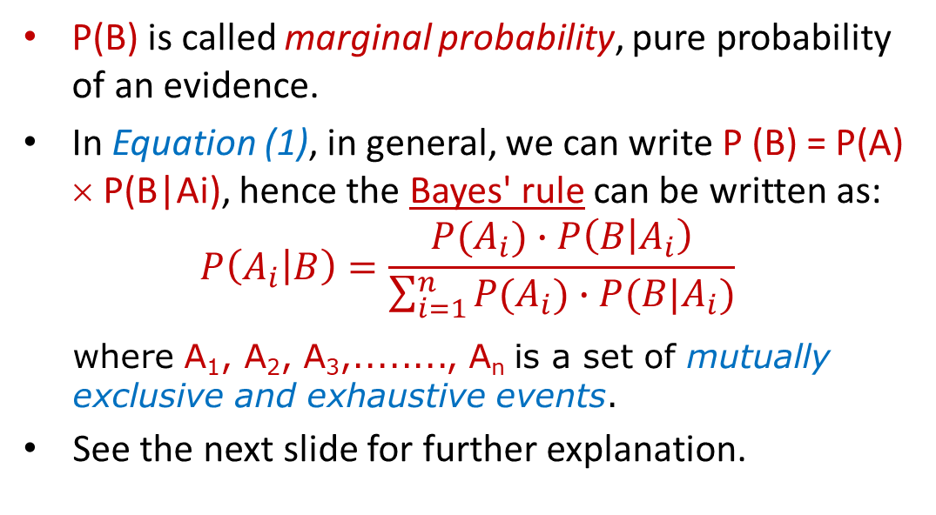
Bayes’ Theorem (6)
P(B) is called marginal probability, pure probability of an evidence.
In Equation (1), in general, we can write P (B) = P(A) × P(B|Ai), hence the Bayes' rule can be written as:
$$P\left(A_{i} | B\right)=\frac{P(A_{i})∙P\left(B | A_{i}\right)}{\sum_{i=1}^{n}{P(A_{i})∙P(B|A_{i})}}$$
where A₁, A₂, A₃,........, A_{n} is a set of mutually exclusive and exhaustive events.
See the next slide for further explanation.

Slide 31
Bayes’ Theorem (7)
P(B) = P(B∩A₁) + P(B∩A₂) + P(B∩A₃) + · · · + P(B∩A_{n})
= P(A₁)·P(B|A₁) + P(A₂)·P(B|A₂) + P(A₃)·P(B|A₃) +
· · · + P(A_{n})·P(B|A_{n})
A₁ A₂ A_{3 · · ·} A_{n}
B

Slide 32
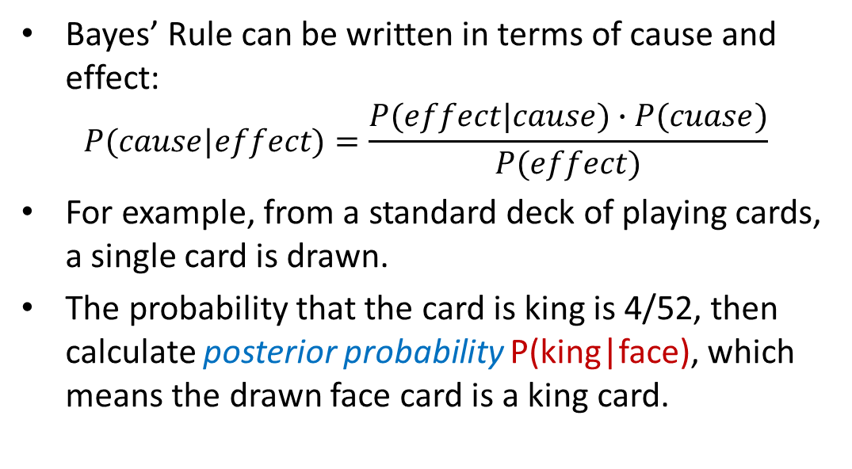
Applying Bayes’ Rule
Bayes’ Rule can be written in terms of cause and effect:
$$P(cause|effect)=\frac{P(effect|cause)∙P(cuase)}{P(effect)}$$
For example, from a standard deck of playing cards, a single card is drawn.
The probability that the card is king is 4/52, then calculate posterior probability P(king|face), which means the drawn face card is a king card.

Slide 33
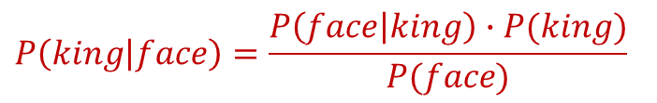
Applying Bayes’ Rule (2)
Solution:
P(king): probability that the card is king = 4/52 = 1/13
P(face): probability that a card is a face card = 3/13
P(face|king): probability of face card when we assume it is a king = 1
$$P\left(king | face\right)=\frac{P\left(face | king\right)∙P(king)}{P(face)}$$
−− Equation (2)

Slide 34

Applying Bayes’ Rule (3)
Putting all values in Equation (2) we will get:
$P\left(king | face\right)=\frac{1∙\frac{1}{13}}{\frac{3}{13}}$ $=\frac{1}{3}$
It is a probability that a face card is a king card.

Slide 35
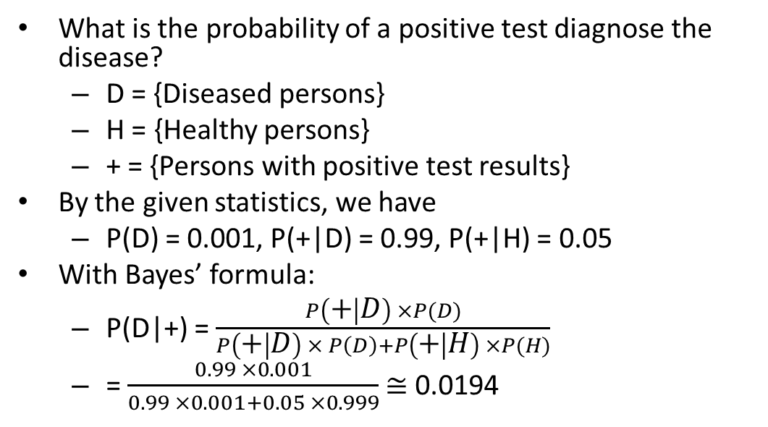
Example: Bayes’ formula
What is the probability of a positive test diagnose the disease?
D = {Diseased persons}
H = {Healthy persons}
+ = {Persons with positive test results}
By the given statistics, we have
P(D) = 0.001, P(+|D) = 0.99, P(+|H) = 0.05
With Bayes’ formula:
P(D|+) = $\frac{P\left(+ | D\right) ×P(D)}{P\left(+ | D\right) × P\left(D\right)+P\left(+ | H\right) ×P(H)}$
= $\frac{0.99 ×0.001}{0.99 ×0.001+0.05 ×0.999}$≅ 0.0194

Slide 36
Use Cases of Bayes’ Rule
Bayes' theorem allows scientists to combine a priori beliefs about the probability of an event (or an environmental condition, or another metric) with empirical (that is, observation-based) evidence, resulting in a new and more robust posterior probability distribution.
There are plenty of applications of the Bayes’ Rule in the real world.

Slide 37
Use Cases of Bayes’ Rule (2)
Here are some common use cases of Bayes’ Rule:
Valuating depression tests performance;
Predicting water quality conditions;
Assisting in COVID tests;
Weather forecasting;
Calculating the moving steps of robots; and
Solving the Monty Hall problem.

Slide 38
L5 – Uncertainty & Probabilistic Reasoning
Uncertainty and Probabilistic Reasoning
Bayes’ Rule
Probabilistic Programming in Pyro

Slide 39
4. Probabilistic Programming in Pyro
An Introduction
Components of Probabilistic Programming
Stochastic Functions
A Simple Model in Pyro
Inference in Pyro

Slide 40
An Introduction
Probabilistic programming (PP) is defined by wiki as a programming paradigm in which probabilistic models are specified and inference for these models is performed automatically.
It can be used to create systems that help make decisions in the face of uncertainty.
One view of probabilistic programming is that it is about automating Bayesian inference.
Probabilistic programming languages (PPLs) are a tool designed specifically for doing inference.

Slide 41

An Introduction (2)
Pyro is a universal probabilistic programming language (PPL) written in Python and supported by PyTorch on the backend.
Pyro enables flexible and expressive deep probabilistic modeling, unifying the best of modern deep learning and Bayesian modeling.

Slide 42
An Introduction (3)
Pyro was designed with these key principles:
Universal: Pyro can represent any computable probability distribution.
Scalable: Pyro scales to large data sets with little overhead.
Minimal: Pyro is implemented with a small core of powerful, composable abstractions.
Flexible: Pyro aims for automation when you want it, control when you need it.

Slide 43
Components of Probabilistic Programming
PPLs are just ordinary programming languages, equipped with tools that make statistical modelling easier for the user, reducing the need for hand-designing programs.
The main components of a PPL are:
Sampling: Our model is probabilistic- it requires drawing values at random from probability distributions.
Conditioning: We have some observed data that can be used to update probabilities.

Slide 44
Components of Probabilistic Programming (2)
The main components of a PPL are (cont.):
Inference: We can learn something from the known data and model.
This could be the parameters of the system or a “latent variable”, some underlying factor that you can’t directly observe but might influence the data.
This is usually the hard part.

Slide 45
Stochastic Functions
The basic unit of probabilistic programs is the stochastic function.
Primitive stochastic functions, or distributions, are an important class of stochastic functions for which we can explicitly compute the probability of the outputs given the inputs.
For example, we draw a sample x from the unit normal distribution N(0,1) as follows.

Slide 46
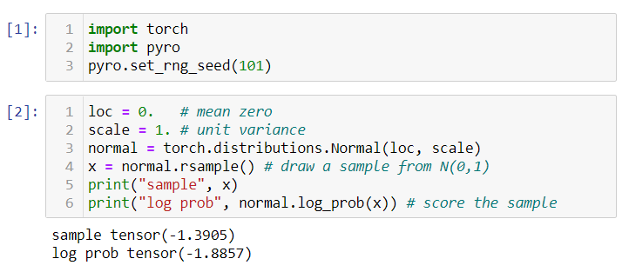
Stochastic Functions (2)
Models.ipynb

Slide 47
A Simple Model in Pyro
All probabilistic programs are built up by composing primitive stochastic functions and deterministic computation.
Suppose we want to reason about how temperature interacts with whether it was sunny or cloudy.
A simple stochastic function that describes how that data might have been generated is given by the following code.

Slide 48
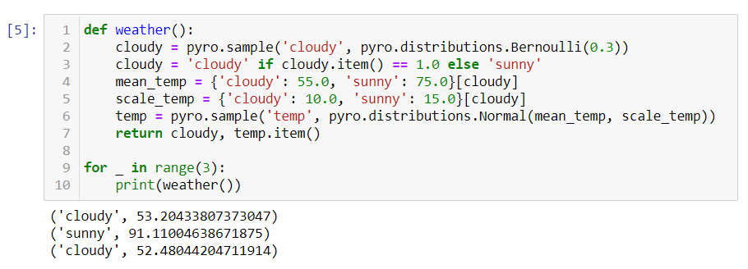
A Simple Model in Pyro (2)
Models.ipynb

Slide 49
Self Study Guide

Slide 50
Self Study Guide
References
Russell, S. and Norvig, P. (2020). Artificial Intelligence: A Modern Approach (4th ed.). Upper Saddle River, NJ: Pearson.
Joshir, P. (2017). Artificial Intelligence with Python (1st ed.). Birmingham: Packt Publishing.

Slide 51
Self Study Guide
Useful Sites
https://www.javatpoint.com/artificial-intelligence-tutorial
https://medium.com/informatics-lab/probabilistic-programming-1535d7882dbe
https://mltrain.cc/wp-content/uploads/2017/10/intro-to-pyro.pdf
https://pyro.ai/
https://docs.pyro.ai/en/stable/
https://buildmedia.readthedocs.org/media/pdf/pyro-ppl/dev/pyro-ppl.pdf
https://pyro.ai/examples/intro_part_i.html
http://docs.pyro.ai/en/0.2.1-release/inference.html

